Slide 1

Spiritual Terms Evaluation

Slide 2


In Step 7, key words were chosen for each chapter.
Now terms will be evaluated across the whole New Testament.

Slide 3
What kinds of terms?
Abstract meaning
Spiritual
meaning
tree
adoption
flesh

Slide 4
?
Why check words across the whole New Testament?
Different translators
Same
words?

Slide 5
1 John 4:14
How God communicated this verse:
The Father has sent the Son to be the Savior of the world.
1
Father
Son
The same verse without Father and Son:
The Master has sent the Beloved One to be the Savior of the world.
2
What is now unclear?
Savior = God
God’s great sacrifice

Slide 6
John 5:17–18
How God communicated these verses (Jesus is speaking):
“My Father is working even now and I, too, am working.” Because of this, the Jews sought even more to kill him because he not only broke the Sabbath, but also called God his own Father, making himself equal with God.
1
“My Father is working even now and I, too, am working.”
His own Father, making himself equal with God.
The same verses without Father:
“My Master is working even now and I, too, am working.” Because of this, the Jews sought even more to kill him because he not only broke the Sabbath, but also called God his own Master, making himself equal with God.
2
What is now unclear?
“Equal with God”

Slide 7
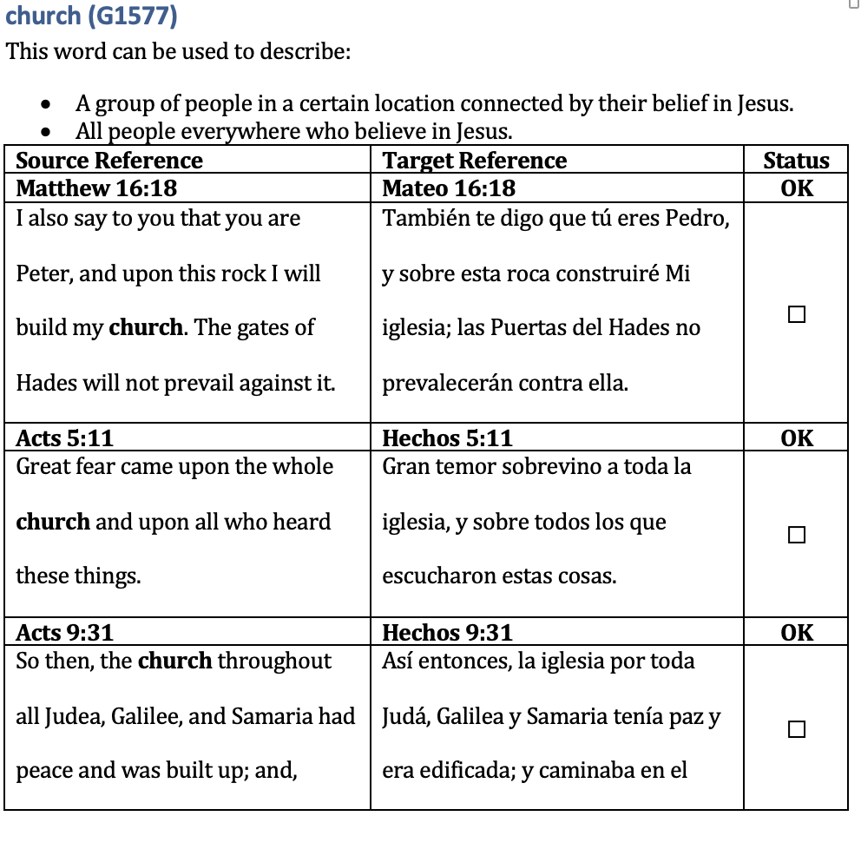

Slide 8
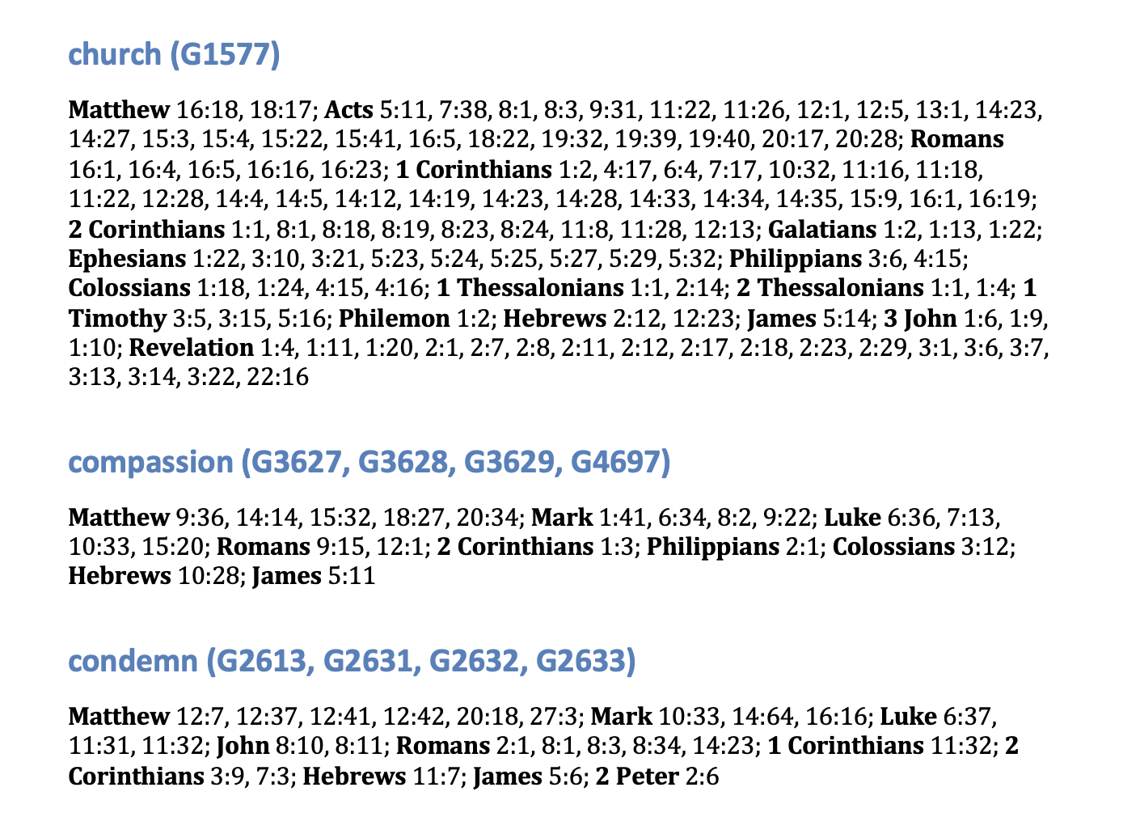

Slide 9
Try it

Slide 10
?
Consistency?
Correct meanings?
Changes?

Slide 11

7/2026

